Slide 1

Global Generative AI Analysis in 2025
Using MySQL Workbench
CREATED BY: ANJALY EM

Slide 2
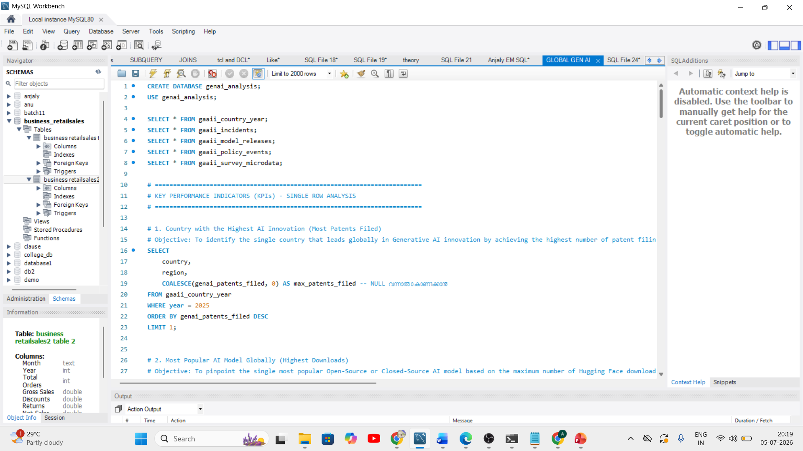
Project Overview
Dataset
Kaggle — Global Generative AI dataset
Tool
MySQL Workbench & SQL
Database
genai_analysis — 5 tables
SQL Techniques
JOIN, GROUP BY, CASE, COALESCE, Aggregates

Slide 3
Project objective
The main objective of this project is to analyze global Generative AI trends in 2025 by combining data from different sources using SQL. The goal is to convert raw data into meaningful business insights that help understand AI adoption, public trust, regulations, risks, and overall country performance.

Slide 4
Database Overview
A relational database named genai_analysis was built in MySQL Workbench, comprising five interconnected tables linked through Country and Year keys. This structure enables cross-referencing across innovation, incidents, regulation, and public opinion.
Country Metrics
AI Incidents
Model Releases
AI readiness, cloud infrastructure, competitiveness scores, and adoption indices by country
Recorded AI-related incidents, financial losses, and incident classifications by country and year
AI model launches, download statistics, and technology classifications across global markets
AI Regulations
Public Surveys
Policy frameworks, regulatory milestones, and governance effectiveness by country
Demographic data on AI trust, job loss fears, and harm perception across population groups

Slide 5

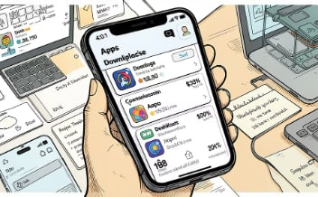


Basic Analysis
Initial queries surfaced high-level trends across patents, model popularity, financial risk, and public sentiment.
AI Patents Leader
Most Popular AI Model
Highest Financial Loss
AI Job-Loss Fear
Identified the country with the highest number of registered AI patents globally
Determined which demographic group reported the highest fear of AI-driven job displacement
Ranked AI models by download volume to determine the most widely adopted
Pinpointed the country with the greatest financial loss from AI-related incidents

Slide 6
Advanced Analysis: Deeper Insights
The advanced phase combined multiple tables and complex SQL logic to explore ten interconnected dimensions of global AI adoption, risk, and governance.
Readiness & Infrastructure
Competitiveness
AI readiness scores correlated with cloud infrastructure investment across nations
Comparative AI competitiveness rankings across countries and regions
Financial Risk
Trust & Employment
Relationship between AI adoption levels and incident-related financial exposure
Public trust levels, job loss fears, and their link to adoption rates
Regulation & Policy
Employment Impact
AI regulatory frameworks assessed for policy effectiveness by country
AI's measurable effect on employment patterns and economic indicators
Digital Divide
Harm Reports vs Records
Gap between high- and low-adoption countries and its structural causes
Discrepancy analysis between public AI harm reports and official incident records
Incident Financial Impact
Overall Performance
Financial breakdown by AI incident type to identify highest-cost categories
Composite country performance scores across all measured AI dimensions

Slide 7

Key Findings
The analysis surfaced clear global patterns in AI innovation, risk, and readiness — with distinct regional leaders and notable disparities in adoption and governance.
1
2
China — Innovation Leader
Stable Audio 2 — Top Model
China leads globally in AI patents and model development, reflecting sustained government and private-sector investment in AI research.
Stable Audio 2 recorded the highest download count among all AI models analyzed, indicating strong demand for generative audio tools.
3
4
Saudi Arabia — Highest Loss
Europe — Strong Readiness
Saudi Arabia recorded the greatest financial loss from AI incidents, highlighting the need for stronger AI risk management frameworks.
European nations demonstrate above-average AI readiness, supported by robust cloud infrastructure and proactive regulatory frameworks.
Successful AI adoption depends on four pillars: technology infrastructure, effective governance, public trust, and workforce reskilling — no single factor is sufficient alone.

Slide 8

Conclusion
To conclude, this project shows how SQL and MySQL Workbench can transform raw data into meaningful business insights. The analysis highlights that AI creates new opportunities for innovation and economic growth, but it also brings challenges such as financial risks, job displacement, and ethical issues. The results show that successful AI adoption depends not only on technology but also on strong regulations, public trust, responsible AI, and workforce reskilling.
Thank You

